Slide 1

STUDENT MANAGEMENT SYSTEM
DBMS MINI PROJECT

Slide 2
ABSTRACT
Student Management System is software which is helpful for students as well as the school authorities. In the current system all the activities are done manually. Its time saving and scalable. Our Student Management System deals with the various activities related to the students
In the software we can register as a user and user has two types student and administrator. Administrator has the power to add new user and can edit the student’s details entered. AN admin can add students record, attendance status with department wise. All students can search his/her basics details and attendance status with their respective roll numbers.

Slide 3
OBJECTIVE
The main objective of the project is to design and develop a user friendly-system. It is easy to use and an efficient computerized system. It helps to develop an accurate and flexible system, it will eliminate data redundancy.
To make software with good user interface so that user can change it and it should be used for a long time without error and maintenance. To make a software fast in processing, with good user interface.
Computerization can be helpful as a means of saving time and money. It provide immediate storage and retrieval of data and information.
There are less chances of information leakage. It also provides Security to the data by using login and password method.

Slide 4
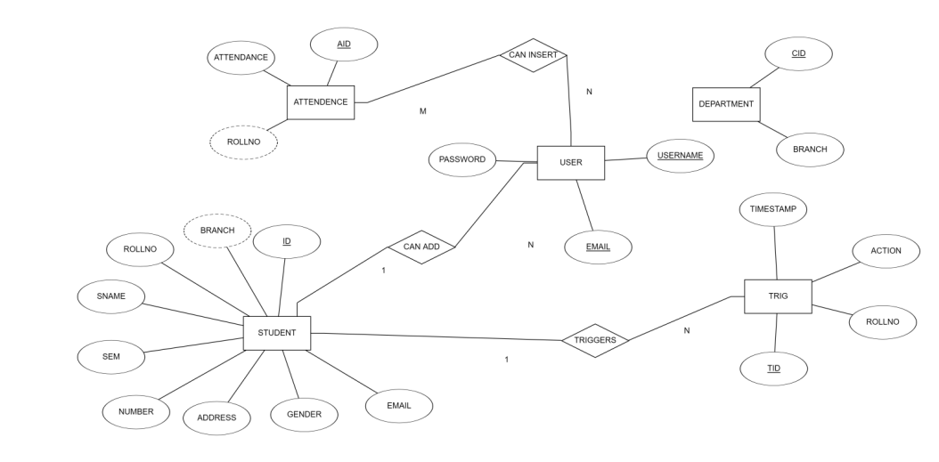
ER DIAGRAM

Slide 5
CONCLUSION
Student Management System successfully implemented based on online data filling which helps us in administrating the data user for managing the tasks performed in students. The project successfully used various functionalities of Xampp and python flask and also create the fully functional database management system for online portals.
Using MySQL as the database is highly beneficial as it is free to download, popular and can be easily customized. The data stored in the MySQL database can easily be retrieved and manipulated according to the requirements with basic knowledge of SQL.

Slide 6
THANK YOU

